Slide 1
Unit 9: Binary I/O, Recursion and Generics
Ravikumar R N
Assistant Professor
Computer Engineering
Marwadi University

Slide 2
Content
Text I/O and Binary I/O
Binary I/O classes
Object I/O
Random access File

Slide 3
Text I/O and Binary I/O
Files can be classified as either text or binary.
A file that can be processed (read, created, or modified) using a text editor such as Notepad, is called a text file.
You cannot read binary files using a text editor, they are designed to be read by programs.
Ex. Java file
Java provides many classes for performing text I/O and binary I/O.
Notes:
A file that can be processed (read, created, or modified) using a text editor such as Notepad on Windows or vi on UNIX is called a text file. All the other files are called binary files.

Slide 4
Text I/O and Binary I/O
Text file - sequence of characters
binary file - sequence of bits
Ex. decimal integer 199 is stored as a sequence of three characters 1, 9, 9 in a text file, and the same integer is stored as a byte-type value C7 in a binary file, because decimal 199 equals hex C7.
The advantage of binary files is that they are more efficient to process than text files.
Java offers many classes for performing file input and output. These can be categorized as text I/O classes and binary I/O classes.

Slide 5
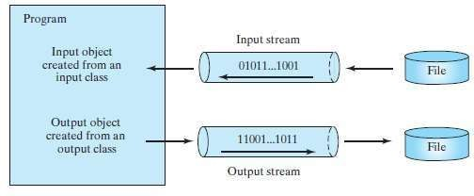
Text I/O
Text data are read using the Scanner class and written using the PrintWriter class.
An input class contains the methods to read data, and an output class contains the methods to write data.

Slide 6
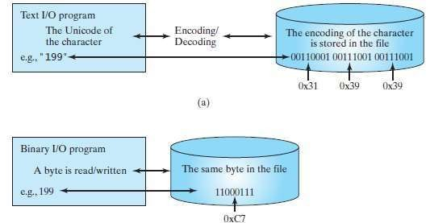
Text I/O vs. Binary I/O
Binary I/O does not involve encoding or decoding and thus is more efficient than text I/O.
All the files in a computer are stored in binary format.
Encoding and decoding are automatically performed for text I/O.

Slide 7
Text I/O vs. Binary I/O
Binary I/O does not require conversions.
Binary files are independent of the encoding scheme on the host machine and thus are portable.
Java programs on any machine can read a binary file created by a Java program. This is why Java class files are binary files. Java class files can run on a JVM on any machine.

Slide 8
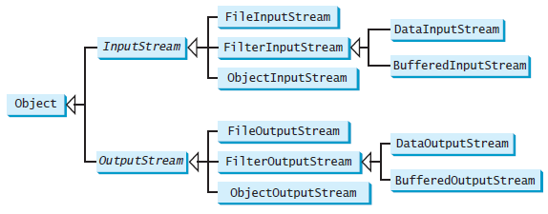
Binary I/O Classes
The abstract InputStream is the root class for reading binary data, and the abstract OutputStream is the rootclass forwriting binary data.

Slide 9
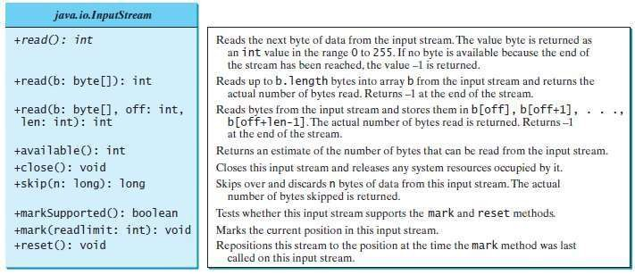
InputStream class

Slide 10
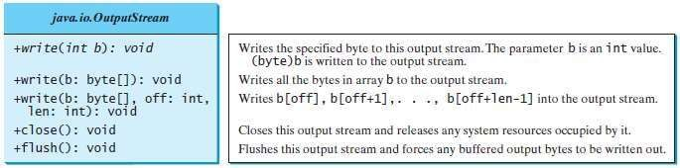
OutputStream class

Slide 11
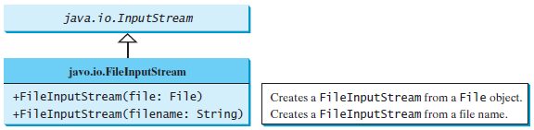
FileInputStream / FileOutputStream
All the methods in these classes are inherited from InputStream and OutputStream.
A java.io.FileNotFoundException will occur if you attempt to create a FileInputStream with a nonexistent file.

Slide 12
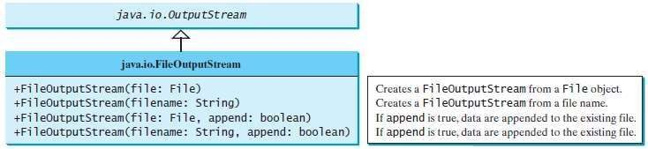
FileInputStream / FileOutputStream
If the file does not exist, a new file will be created. If the file already exists, the first two constructors will delete the current content of the file.
To retain the current content and append new data into the file, use the last two constructors and pass true to the append parameter.

Slide 13
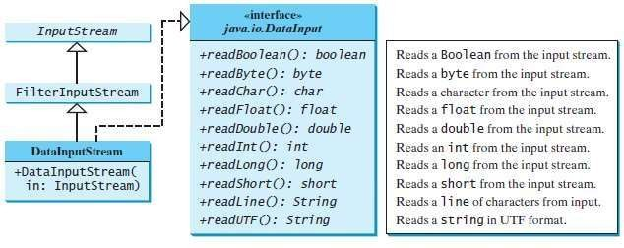
DataInputStream/ DataOutputStream
DataInputStream reads bytes from the stream and converts
them into appropriate primitive-type values or strings.
DataOutputStream converts primitive-type values or strings into bytes and outputs the bytes to the stream.

Slide 14
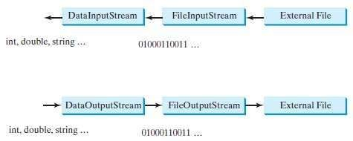
DataInputStream/DataOutputStream
DataInputStream and DataOutputStream read and write Java primitive-type values and strings in a machine-independent fashion, thereby enabling you to write a data file on one machine and read it on another machine that has a different operating system or file structure.

Slide 15
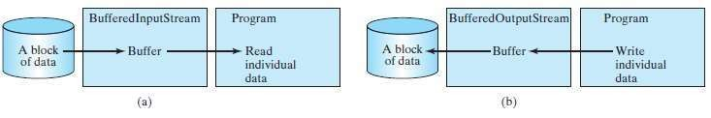
BufferedInputStream/ BufferedOutputStream
BufferedInputStream/BufferedOutputStream can be used to speed up input and output by reducing the number of disk reads and writes.

Slide 16
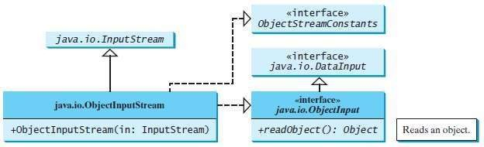

Object I/O
ObjectInputStream/ ObjectOutputStream classes can be used to read/write serializable objects.
Notes:
Serializable object means to convert its state to a byte stream.

Slide 17
The Serializable Interface
A serializable object is an instance of the java.io.Serializable interface, so the object’s class must implement Serializable.
Serialization in Java is a mechanism of writing the state of an object into a byte-stream.
The Serializable interface is a marker interface. Since it has no methods, you don’t need to add additional code in your class that implements Serializable.
Java provides a built-in mechanism to automate the process of writing objects. This process is referred as object serialization, which is implemented in ObjectOutputStream.

Slide 18
Random-Access Files
Java provides the RandomAccessFile class to allow data to be read from and written to at any locations in the file.
All of the streams you have used so far are known as read-only or write-only streams. These streams are called sequential streams.
Java provides the RandomAccessFile class to allow data to be read from and written to at any locations in a file. A file that is opened using the RandomAccessFile class is known as a random-access file.
The RandomAccessFile class implements the DataInput and
DataOutput interfaces.
When creating a RandomAccessFile, you can specify one of two modes: r or rw. Mode r means that the stream is read-only, and mode rw indicates that the stream allows both read and write.

Slide 19
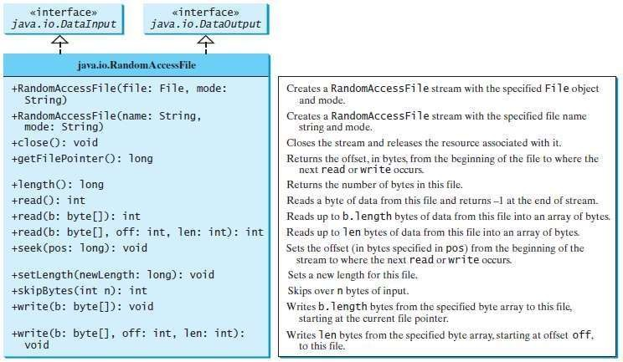

Slide 20
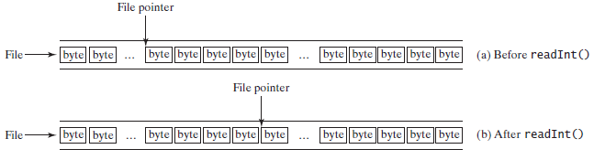
Random-Access Files
A random-access file consists of a sequence of bytes. A special marker called a file pointer is positioned at one of these bytes.
For example, if you read an int value using readInt(), the JVM reads 4 bytes from the file pointer.

Slide 22
Content
Recursion
Problem Solving using Recursion
Recursive Helper Methods
Recursion vs. Iteration
Tail Recursion

Slide 23
Recursion
Recursion is a technique that leads to elegant solutions to problems that are difficult to program using simple loops.
In some cases, it enables you to develop a natural, straightforward, simple solution to an otherwise difficult problem.
A recursive method is one that invokes itself.

Slide 24
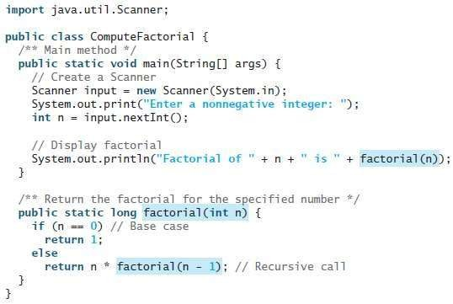
Factorial Program

Slide 25
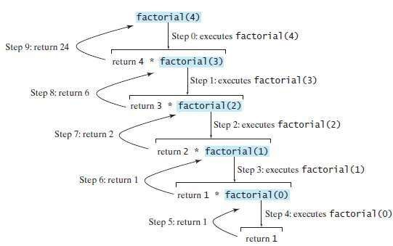
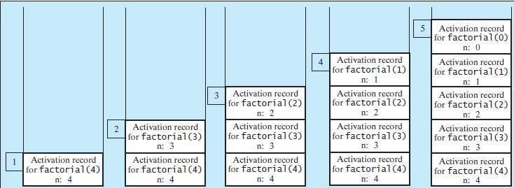

Slide 26

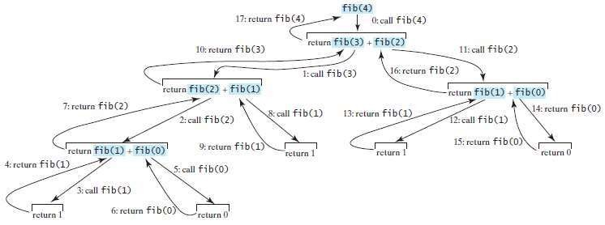
Fibonacci Series
In some cases, recursion enables you to create an intuitive, straightforward, simple solution to a problem.

Slide 27
Problem Solving Using Recursion
If you think recursively, you can solve many problems using
recursion.
Factorial and Fibonacci series are two classic recursion examples. All recursive methods have the following characteristics:
The method is implemented using an if-else ora switch
statement that leads to different cases.
One or more base cases (the simplest case) are used to stop
recursion.
Every recursive call reduces the original problem, bringing it
increasinglycloser to a base case until it becomes that case.

Slide 28
Problem Solving Using Recursion
Consider the palindrome problem.
For example, “mom” and “dad” are palindromes, but “uncle” and “aunt” are not. The problem of checking whether a string is a palindrome can be divided into two sub problems:
Check whether the first character and the last character of the string are equal.
Ignore the two end characters and check whether the
rest of the substring is a palindrome.

Slide 29
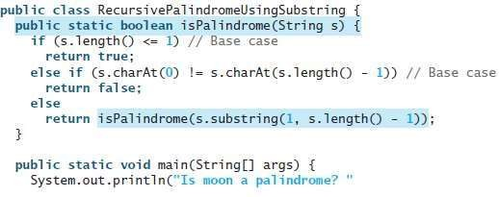
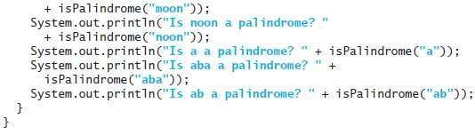


Slide 30
Recursive Helper Methods
Sometimes you can find a solution to the original problem by defining a recursive function to a problem similar to the original problem. This new method is called a recursive helper method. The original problem can be solved by invoking the recursive helper method.
The recursive isPalindrome method is not efficient, because it creates a new string for every recursive call. To avoid creating new strings, you can use the low and high indices to indicate the range of the substring.

Slide 31
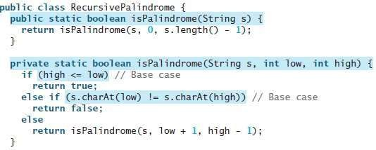
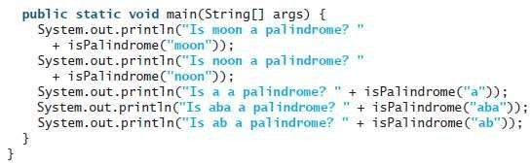

Slide 32
Recursion vs. Iteration
Recursion is an alternative form of program control. It is
essentially repetition without a loop.
The repetition of the loop body is controlled by the loop
control structure.
In recursion, the method itself is called repeatedly. A selection statement must be used to control whether to call the method recursively or not.
Recursion bears substantial overhead. Each time the program calls a method, the system must allocate memory for all of the method’s local variables and parameters. This can consume considerable memory and requires extra time to manage the memory.

Slide 33
Recursion vs. Iteration
Any problem that can be solved recursively can be solved nonrecursively with iterations. Recursion has some negative aspects: it uses up too much time and too much memory.
Examples are the directory-size problem, the Tower of Hanoi problem, and the fractal problem, which are rather difficult to solve without using recursion.
The decision whether to use recursion or iteration should be based on the nature of, and your understanding of, the problem you are trying to solve.

Slide 34




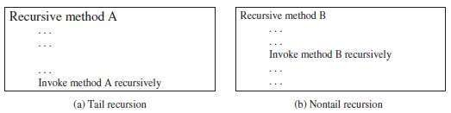
Tail Recursion
A tail recursive method is efficient for reducing stack size.
A recursive method is said to be tail recursive if there are no pending operations to be performed on return from a recursive call.
For example, the recursive isPalindrome method is tail recursive because there are no pending operations after recursively invoking isPalindrome.

Slide 35
Tail Recursion
The recursive factorial method is not tail recursive, because there is a pending operation, namely multiplication, to be performed on return from each recursive call.
Tail recursion is desirable, because the method ends when the last recursive call ends, there is no need to store the intermediate calls in the stack. Compilers can optimize tail recursion to reduce stack size.

Slide 36
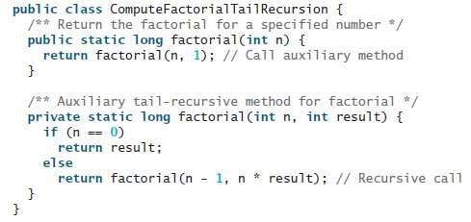
Factorial Program using Tail Recursion

Slide 37
Content
Generics
Defining Generic Classes and Interfaces
Generic Methods
Raw Types and Backward Compatibility
Wildcard Generic Types
Erasure and Restrictions on Generics

Slide 38
Generics
Generics enable you to detect errors at compile time rather
than at runtime.
Generics let you parameterize types. With this capability, you can define a class or a method with generic types that the compiler can replace with concrete types.
For example, Java defines a generic ArrayList class for storing the elements of a generic type. From this generic class, you can create an ArrayList object for holding strings and an ArrayList object for holding numbers. Here, strings and numbers are concrete types that replace the generic type.

Slide 39

Generics
<T> or <E> represents a generic type, which can be replaced later with an actual concrete type. Replacing a generic type is called a generic instantiation. Here, E or T is used to denote a formal generic type.

Slide 40

Generics
Fig (a) : c is a reference variable whose type is Comparable and invokes the compareTo method to compare a Date object with a string. It will give run time error.
Fig (b) : This code generates a compile error, because the argument passed to the compareTo method must be of the Date type.

Slide 41
Generics
Type Parameters
Naming conventions are important to learn in generics. Commonly used parameters are,
T – Type
E – Element
K – Key
N – Number
V – Value

Slide 42

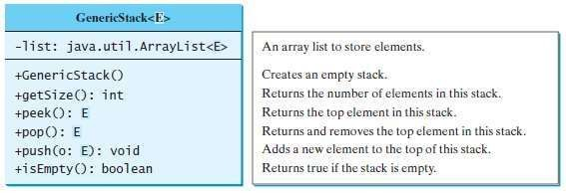
Defining Generic Classes and Interfaces
A generic type can be defined for a class or interface. A concrete type must be specified when using the class to create an object or using the class or interface to declare a reference variable.

Slide 43
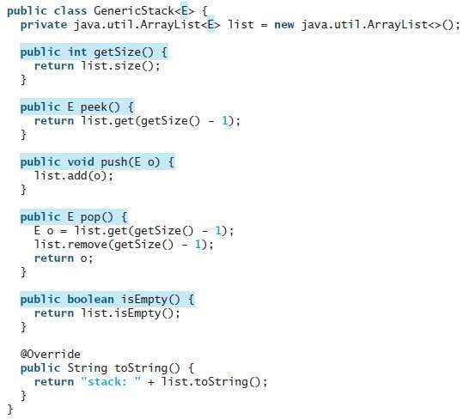



Slide 44
Generic Classes Example
class gen<T> //brackets indicates the class is of generic type // class Test<T, U>
{
T obj; //an object of type T is created
gen(T obj) {
this.obj =obj;
}
public void print() {
System.out.println(obj);
} }
class Demogen
{
public static void main(String args[]) {
gen<Integer> iob=new gen<Integer>(100);
iob.print();
gen<String> sob=new gen<String>("Hello");
sob.print();
} }
Output: 100
Hello

Slide 45
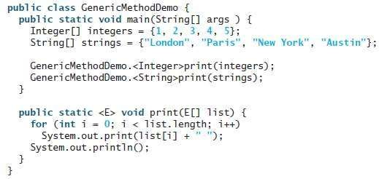
Generic Methods
A generic type can be defined fora static method.
Here, it defines a generic method print to print an array of objects.
It passes an array of integer objects to invoke the generic print method and invokes print with an array of strings.

Slide 46
Generic Methods
To declare a generic method, you place the generic type <E> immediately after the keyword static in the method header.
For example, public static <E> void print(E[] list)
To invoke a generic method, prefix the method name with the actual type in angle brackets. If actual type is not explicitly specified, then compiler automatically discovers the actual type.

Slide 47
Generic Methods
class Test
{
// A Generic method example
static void genericDisplay (T element) {
System.out.println(element.getClass().getName() + " = " + element);
}
public static void main(String[] args)
{
genericDisplay(11);
genericDisplay("Hello");
genericDisplay(1.0);
}
}
Output :
java.lang.Integer = 11
java.lang.String = Hello
java.lang.Double = 1.0

Slide 48
Raw Types and Backward Compatibility
A generic class or interface used without specifying a concrete type, called a raw type, enables backward compatibility with earlier versions of Java.
For Ex. GenericStack stack = new GenericStack(); // raw type
Which is equivalent to
GenericStack<Object> stack = new GenericStack<Object>();
A generic class such as GenericStack and ArrayList used without a type parameter is called a raw type.
Generic type has been used in java.lang.Comparable since JDK 1.5, but a lot of code still uses the raw type Comparable.

Slide 49

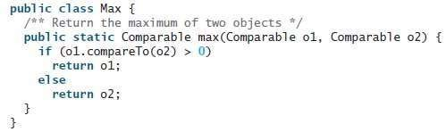
Raw Types and Backward Compatibility
Comparable o1 and Comparable o2 are raw type declarations. Be careful: raw types are unsafe.
For example, you might invoke the max method using Max.max("Welcome", 23);
This would cause a runtime error, because you cannot compare a string with an integer object.

Slide 50
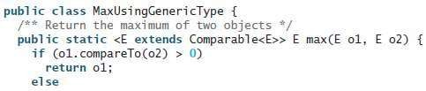

Raw Types and Backward Compatibility
A better way to write the max method is to use a generic type.
MaxUsingGenericType.max("Welcome", 23);
Here, compile errorwill be displayed, because the two arguments of the max method in MaxUsingGenericType must have the same type.

Slide 51
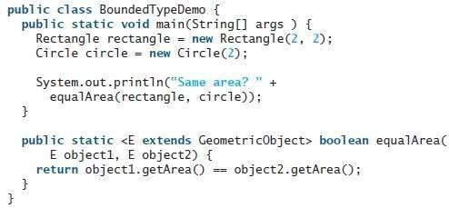
Bounded Generics
A generic type can be specified as a subtype of another type. Such a generic type is called bounded.

Slide 52
Bounded Generics
Bounded type is used to limit or restrict the type of object passed to the parameterized type.
Ex: if we want a generic class to work only with numbers
Syntax: <T extends SuperClass> i.e. <T extends Number>
class gen<T extends Number> {
T obj;
gen(T obj) {
this.obj =obj;
}
public void print() {
System.out.println(obj);
} }
class Demogen {
public static void main(String args[]) {
gen<Integer> iob=new gen<Integer>(100);
iob.print();
//gen<String> sob=new gen<String>("Hello");
//sob.print(); } }

Slide 53
Wildcard Generic Types
You can use unbounded wildcards, bounded wildcards, or lower-bound wildcards to specify a range for a generic type.
To circumvent this problem, use wildcard generic types. A wildcard generic type has 3 forms:
⚫?
? extends T,
? super T,
Solution:
unbounded wildcard bounded wildcard lower-bound wildcard
public static double max(GenericStack<? extends Number> stack) {

Slide 54
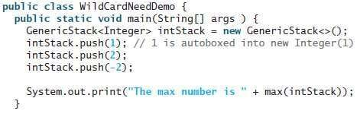
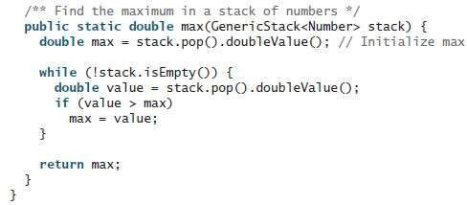
Error

Slide 55
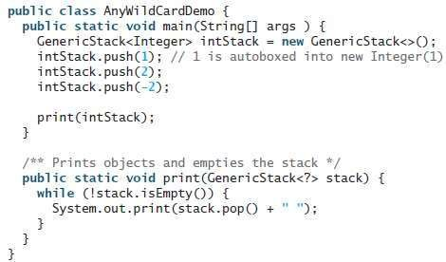
Solution of Previous Example

Slide 56

Erasure and Restrictions on Generics
The information on generics is used by the compiler but is not available at runtime. This is called type erasure.
Generics are implemented using an approach called type erasure: The compiler uses the generic type information to compile the code, but erases it afterward. Thus, the generic information is not available at runtime. This approach enables the generic code to be backward compatible with the legacy code that uses raw types.

Slide 57

Erasure and Restrictions on Generics
The generics are present at compile time. Once the compiler confirms that a generic type is used safely, it converts the generic type to a raw type.
Here, compiler checks whether the following code in (a)uses generics correctly and then translates it into the equivalent code in (b) for runtime use.

Slide 58
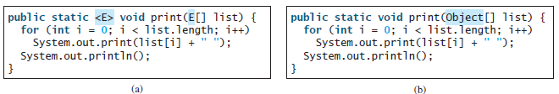
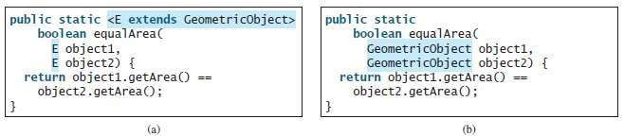
Erasure and Restrictions on Generics
When genericclasses, interfaces, and methods are compiled, the
compiler replaces the generic type with the Object type.
If a generictype is bounded, the compiler replaces it with the
bounded type.

Slide 59
Erasure and Restrictions on Generics
For ex, ArrayList<String> and ArrayList<Integer> are two types at compile time, only one ArrayList class is loaded into the JVM at runtime.
Because generic types are erased at runtime, there are certain restrictions on how generic types can be used. Restrictions:
1. Restriction 1: Cannot Use new E()
E object = new E(); // Not allowed
Because new E() is executed at runtime, but the generic type E is not available at runtime.

Slide 60
Restrictions on Generics
Restriction 2: Cannot Use new E[]
E[] elements = new E[capacity]; // Not Allowed
Restriction 3: A Generic Type Parameter of a Class Is Not Allowed in a Static Context
The staticvariables and methods of a generic class are shared by all its instances. Therefore, it is illegal to refer to a generic type parameter for a class in a static method, field, or initializer.
4. Restriction 4: Exception Classes Cannot Be Generic

Slide 61
End of chapter 9

